Slide 1
Chap#15
Succession Planning And Strategies For Harvesting And Ending The Venture

Slide 2
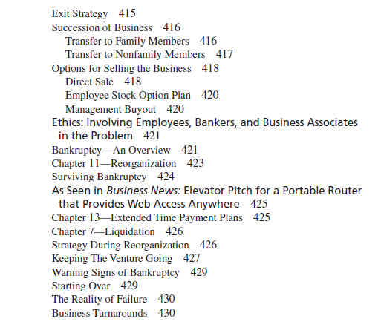
Contents

Slide 3
EXIT STRATEGY
Exit strategies include an initial public offering , private sale of stock, succession by a family member or a nonfamily member, merger with another company, or liquidation of the company. The sale of the company could be to employees or to an external source (a person or persons, or a company).
The most important issue is that the entrepreneurs have an exit strategy or plan in place at the start-up stage, instead of waiting until it may be too late to effectively implement a desirable option.
Notes:
Liquidation= settle debt by payment or other settlement

Slide 4
SUCCESSION OF BUSINESS
Only about 60 percent of businesses have a succession plan in place. For very small businesses,this percentage is likely to be a lot lower.
If there is no one in the family interested in the business, it is important for the entrepreneur to either sell the business or train someone within the organization to take over.
Notes:
Succession->one after the other successful

Slide 5
Continue----Transfer to Family Members
Successfully passing down a business to a family member faces tough odds. Research by the Family Business Institute indicates that only 30 percent of family businesses survive into the second generation and only 12 percent survive into the third generation. This data clearly supports the need for a succession plan.
succession plan should also be communicated clearly to all employees
Look into these things role of the owner in the transition stage,full time work,part time work,owner retirement,people unable towork together,income setting,business environment, Treatment of loyal employees,Tax consequences.

Slide 6
Succession Planning Tips
• Allow sufficient time for the process by starting early.
• Estimate the firm’s value or hire a consultant to do it for you.
• Evaluate potential successors on their merit—not on whether they remind you of yourself.
• If family members are being considered, make sure they have the skills and motivation necessary to carry on the business.
• Provide a transition period so that the successor can learn the business.
• Consider options such as employee stock option plans (ESOPs) for a management succession.
• Set a date for completion of the transition and stick to it.

Slide 7
Continue…. Transfer to Nonfamily Members
Entrepreneur has three choices: train a key employee and retain some equity,retain control and hire a manager, or sell the business outright.
Passing the business on to an employee ensures that they are familiar with the business and the market. The employee’s experience minimizes transitional problems.
If the entrepreneur plans to retain some ownership, the question of how much becomes an important area of negotiation.
Succession plan should consider the following important issues:5
• Senior management of the company must be committed to any succession plan. The strategy must be one that everyone shares.
• It is important to have well-defined job descriptions and a clear designation of skills necessary to fulfill any and all positions.
• The process needs to be an open one. All employees should be invited to participate so that they will feel comfortable with the transition and thus minimize the possibility of their leaving the company.

Slide 8
OPTIONS FOR SELLING THE BUSINESS
Direct Sale
The entrepreneur may decide to sell the business because he or she wants to move on to some new endeavor or simply decides that it is time to retire.
Considerations:
• A business can be more valuable if it is focused on a narrow, well-defined segment. In other words, a larger share in a small market niche can be more valuable than a smaller share in a large market.
• The entrepreneur should concentrate on keeping costs under control and focus on higher margins and profits.
• Get all financial statements in order, including budgets and cash flow projections.
• Prepare a management documentation of the business explaining how the business is organized and how it operates.
Up-to-date or state-of-the-art equipment can enhance the value of a company.
Get tax advice, since the sale of a corporation will involve different tax considerations
• Get nondisclosures(refuse to share a lot info) from key employees.
• Try to maintain a good management team, allowing them to have day-to-day contact with key customers
There is no substitute for advance preparation and planning.

Slide 9
Continue…
Employee Stock Option Plan
Employee stock option plan (ESOP), the business is sold to employees over a period of time. The ESOP establishes a new legal entity, called an employee stock ownership trust, that borrows the money against future profits.
The ESOP has the obligation to repay the loan plus interest out of the cash flow of the business.

Slide 10
Continue…
Management Buyout
Entrepreneur only wants to sell or transfer the venture to loyal, key employees.
Sale of a venture to key employees can be for cash, or it can be financed in any number of ways.
These funds would then be used as a full or partial payment for the venture.

Slide 11
BANKRUPTCY
Failure is not uncommon in many new ventures
Half of all new start-ups fail in their first years
It is important to understand the issues involved in bankruptcy
The results of each bankruptcy filing can be quite distinct because of the nature of the business or the uniqueness of an industry.
Pg 423 Lessons to Learn
REORGANIZATION(courts try to give the venture to pay its debts, Extension, Substitution, Composition settlement)
Surviving Bankruptcy(in time measures->protection)
EXTENDED TIME PAYMENT PLANS
LIQUIDATION(assets of the business)
Notes:
voluntary bankruptcy Entrepreneur’s decision to file for bankruptcy
involuntary bankruptcy Petition of bankruptcy filed by creditors without consent of entrepreneur

